Slide 1
Decoding sounds/blends/words
one

Slide 2
Long and short vowels
The English vowels are A, E, I, O, & U. (Sometimes Y is a vowel, pronounced as if it were I, and sometimes W substitutes for U.)
Each can be pronounced in several ways.

Slide 3
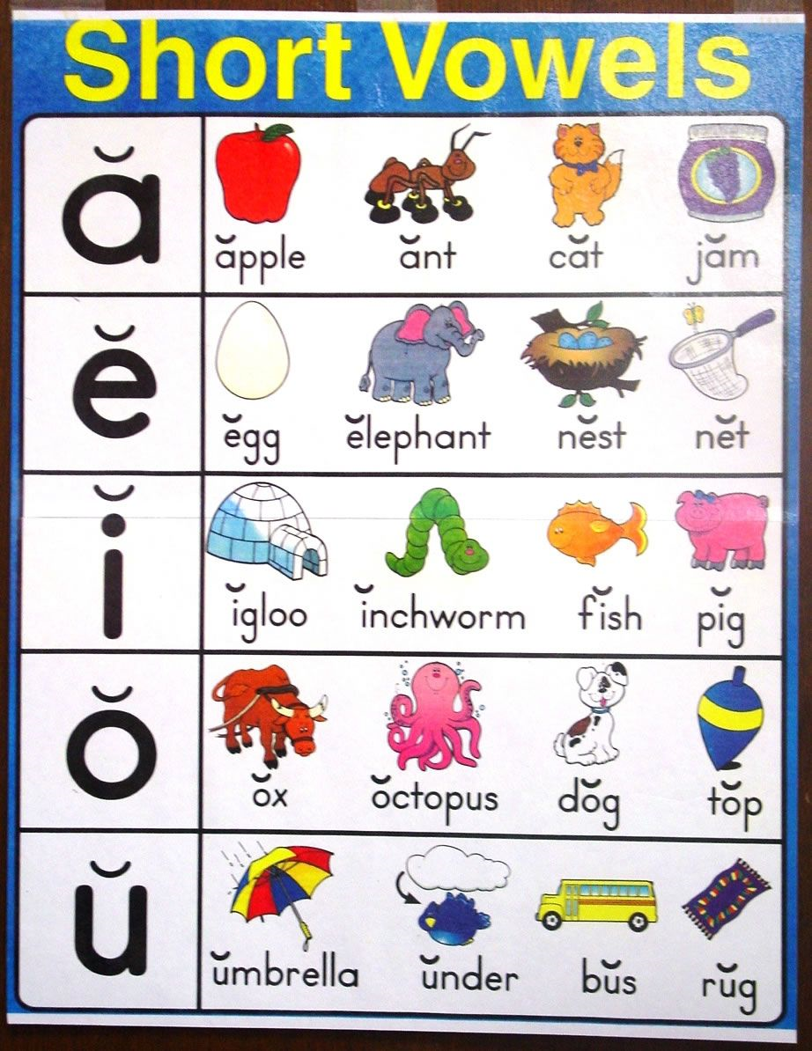
Short Vowels
The most common sound for each vowel is its “short” sound:

Slide 4
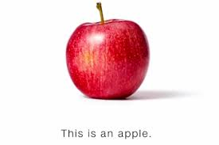
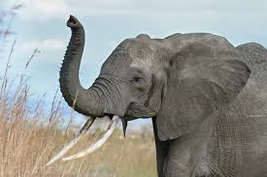
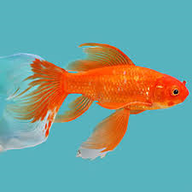
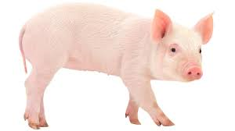
ă, pronounced /æ/ as in apple, pan, or mat,
ĕ, pronounced /ɛ/as in elephant, pen, or met,
ĭ, pronounced /ɪ/as in insect, pin, or mitt,

Slide 5
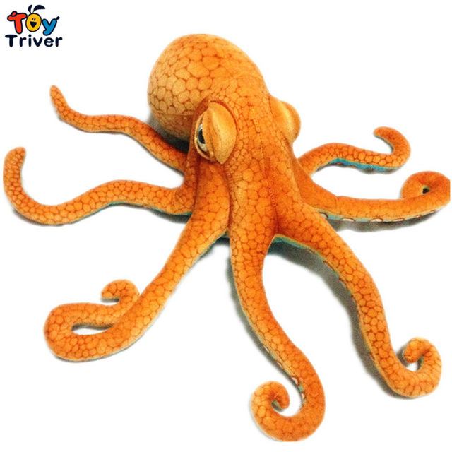
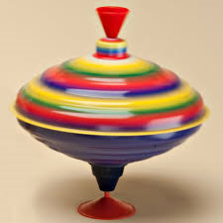
ŏ, pronounced /ɒ/ as in ostrich, upon, or motto,
and ŭ, pronounced /ʌ/ as in umbrella, pun, or mutt.

Slide 6
When syllables end in a vowel and then consonant, the vowel is usually short.
PUN
If there is more than one consonant, the vowel is almost always short.
MITT

Slide 7
This becomes important as a way to keep the same vowel sound when adding -ed to put a verb into the past tense.
WALK….WALKED
We often double an ending consonant to keep a short vowel short. For example, the past tense of 'stop' is 'stopped.‘
There is an exception which will be looked at with long vowels.

Slide 8
Silent e rule
When a vowel and consonant are followed by an ‘e’, the ‘e’ is almost always
silent, but it causes the preceding vowel to be long. (Examples: ate, plane, Pete, bite, nine, rope, note, cube, flute.)

Slide 10
Long vowels
The alphabet sounds (when the vowel “says its name”) are called “long vowels.”
We call them ‘long’ because we hold them longer than the short sounds, but they are completely different sounds-- not a longer version of the same sound.

Slide 11
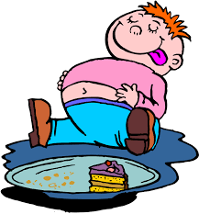
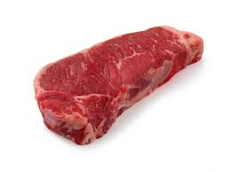
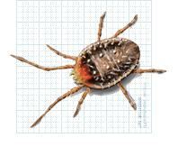
Long A (ā ), pronounced /eɪ/ as in ate or mate,
Long E (ē ), pronounced /iː/ as in eat or meat (or meet or mete-- all pronounced the same),
Long I (ī), pronounced /aɪ/ in mite or might,

Slide 13
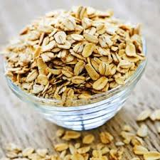
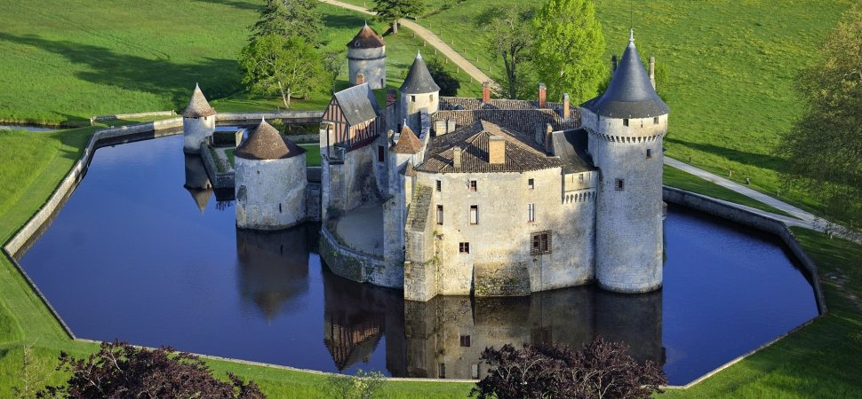
Long O (ō), pronounced /oʊ/as in oats, mote or moat, and
Long U (ū), pronounced /juː/ in mute.

Slide 14
Other long vowels
A vowel at the end of a syllable is almost always long. Examples: I, we, he,
she, go, try, potato and tomato.
(Some English speakers use a short ‘a’ in the 2nd syllable, (potato, tomato) while others use a long ‘a,’ but both ‘o’s are long for everyone [potato, tomato].)

Slide 15
igh and -ight are usually long i (and silent GH): bright, fight, high, light, might, night, right, sigh, sight, tight.

Slide 16
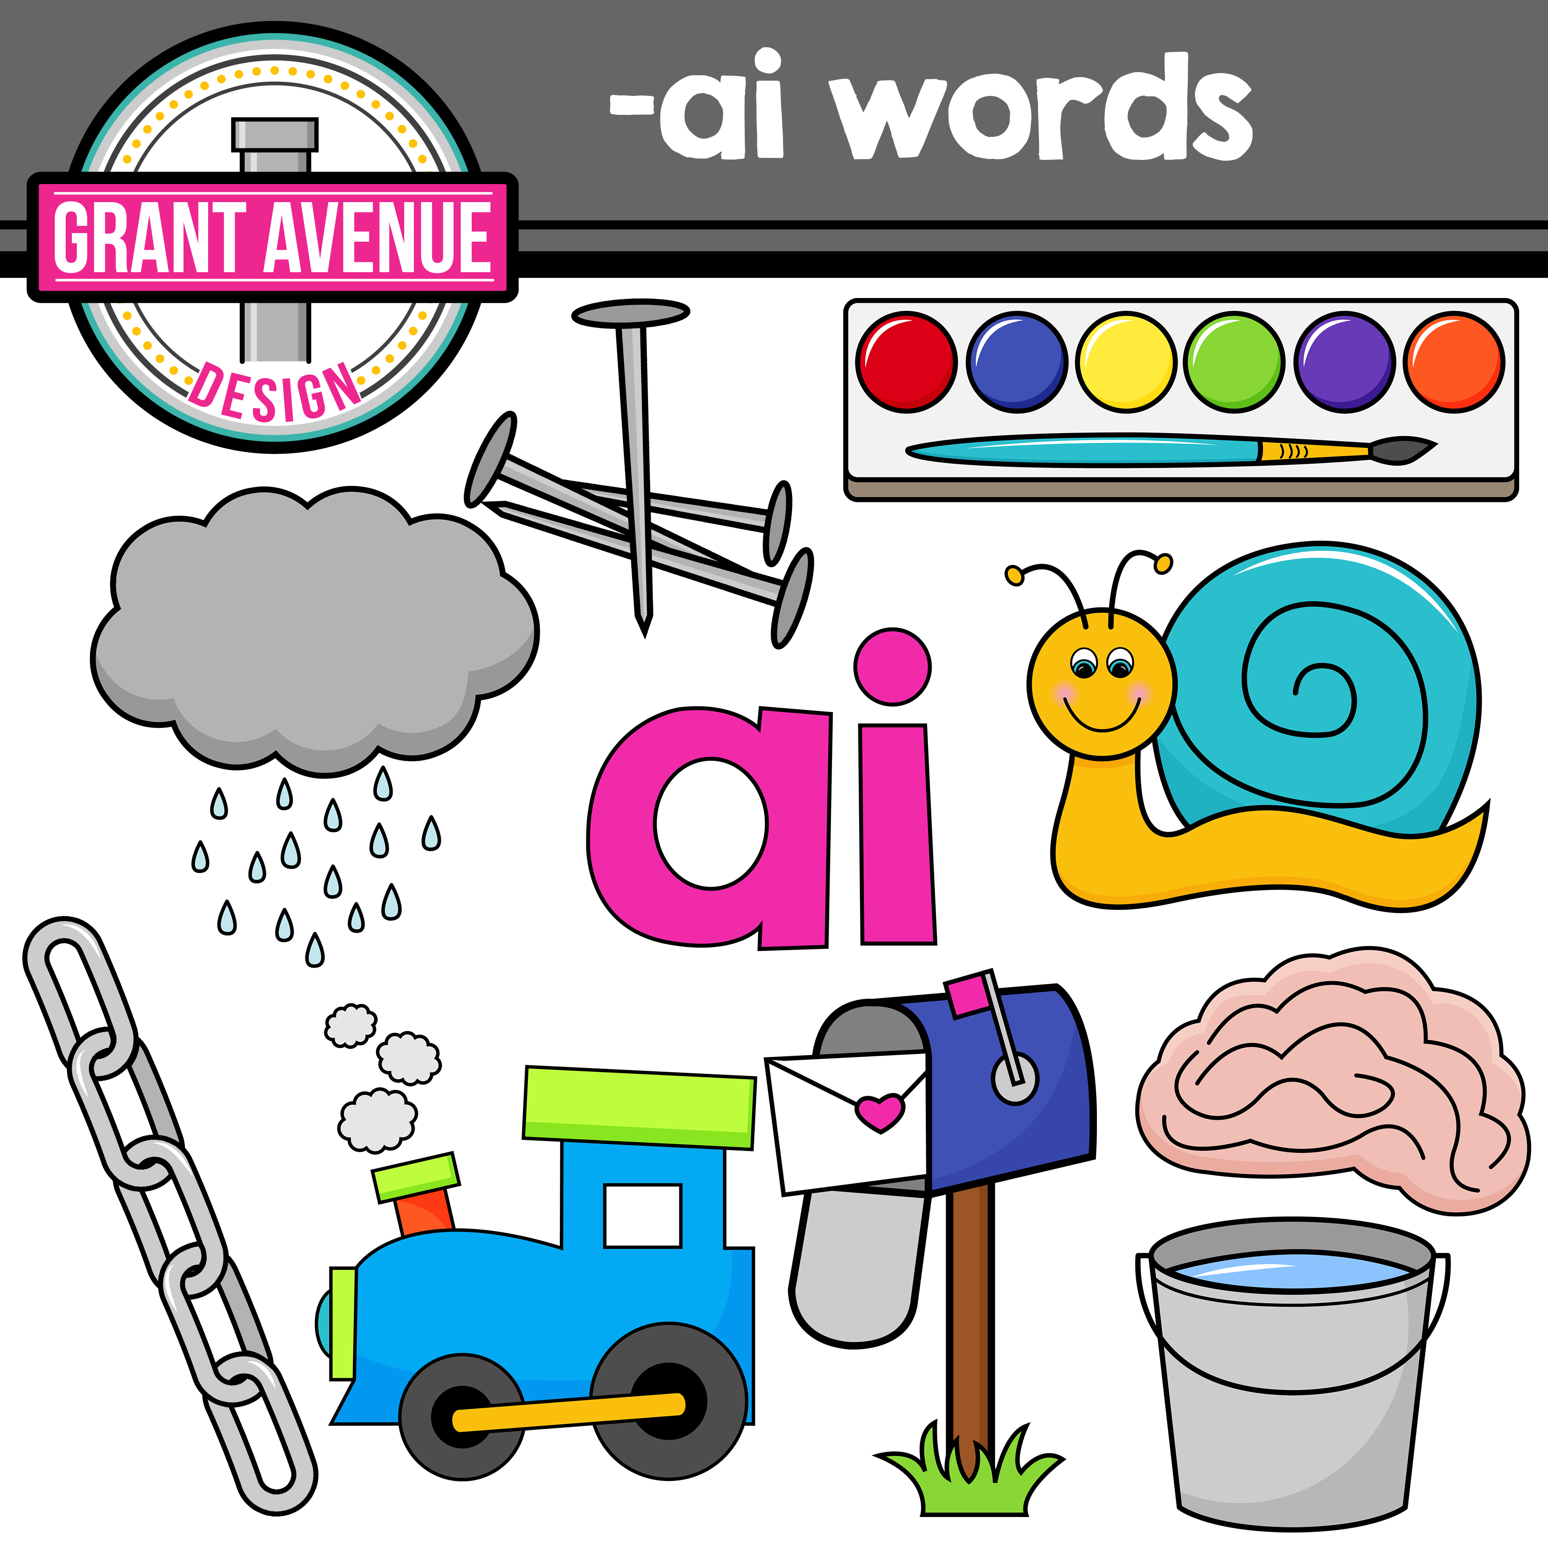
Vowel combinations
Often the first letter of the vowel combinations, will be long, especially in the following:
‘ai’

Slide 17
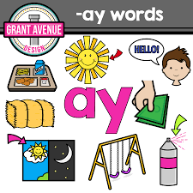
‘ay’

Slide 18
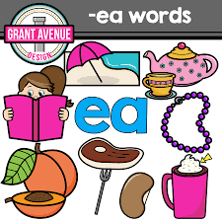
‘ea’

Slide 19
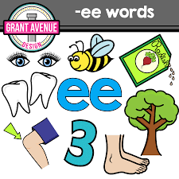
‘ee’

Slide 20
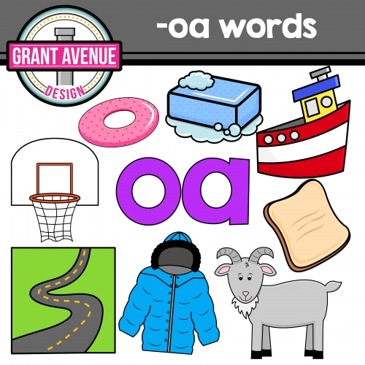
‘oa’

Slide 21
The second vowel will be silent.

Slide 22
An old rhyme for children says “when two vowels go walking, the first does the talking.”
So ’plain’ sounds just like ‘plane,'
‘meat’ like ‘meet’
THERE ARE EXCEPTIONS

