Slide 1
Technological Developments are Making Space Exploration Possible and Offer Benefits on Earth
Unit E: Topic Two

Slide 2
2.1 Getting There: Technologies for Space Travel

Slide 3
Biggest Hurdles in Space Travel
To go fast enough to achieve orbit around Earth or break free of Earth’s gravity and travel to other planets
Gravitational escape velocity had to be reached (28,000 km/hr) if humans were to venture into space
To keep equipment operating in the extreme environment of space such as in high levels of radiation, against small celestial particles, in extreme temperatures
To transport people out and back safely

Slide 4
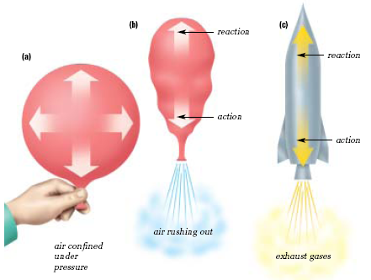
The Science of Rocketry
Law of Physics: For every action, there is an equal and opposite reaction.
This law was proposed by Sir Isaac Newton

Slide 5
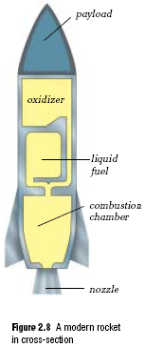
Three Basic Parts to a Rocket
Structural and mechanical elements
Engines, storage tanks, fins.
Fuel
Liquid oxygen, gasoline, liquid hydrogen. The mixture is ignited in a combustion chamber, causing the gases to expand and leave as exhaust.
The speed that the exhaust leaves the rocket at is the exhaust velocity.
Payload
Materials needed for flight: crew cabins, food, water, air, people.

Slide 6
The future of Space Transport Technology
If humans are to visit other bodies in our solar system, technology still has a long way to advance.
New devices are being considered for propelling spacecraft between planets.

Slide 7
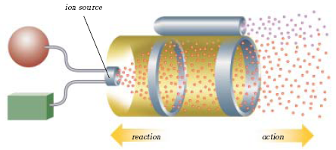
The future of Space Transport Technology
Ion Drives
Engines that use xenon gas instead of chemical fuels
Xenon is electrically charged, accelerated, and then emitted as exhaust.
The thrust is much weaker than using chemical fuels, but even a little bit of force lasts a long period of time.
Benefit: Uses 10% (1/10) of the fuel that conventional spacecrafts use.

Slide 8
Ion Drives
http://www.youtube.com/watch?v=drJ0gGz3e4o

Slide 9
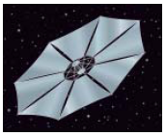
The future of Space Transport Technology
Solar Sails
Solar sails would use the photons emitted from the sun to propel the sails. (Kind of like propelling boats using wind sails)
Use of solar sails is expected by 2015.
Benefit: It is estimated that spacecraft powered by solar sails could travel 5x faster
than a current spacecraft.

Slide 10
Solar Sailing
http://www.youtube.com/watch?v=pMmwAy84qK8

Slide 11
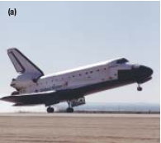
Shuttles, Space Probes, and Space Stations
Space shuttle: transports personnel and equipment to orbiting spacecraft.
NASA has three space shuttles: Discovery (1983), Atlantis (1985), Endeavor (1991)
Uses: service and repair orbiting satellites, to return previously deployed
spacecraft, and to conduct
scientific experiments in space.

Slide 12
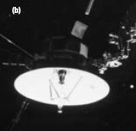
Shuttles, Space Probes, and Space Stations
Space probes: contain instrumentation for carrying out robotic exploration of space, while communicating information back to Earth.

Slide 13
The Universe Secrets of the Space Probes
http://www.youtube.com/watch?v=-gjpvyJ8v-s
Part 1 – 15 minutes

Slide 14
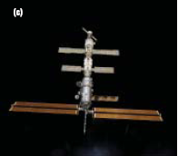
Shuttles, Space Probes, and Space Stations
Space Stations: orbiting spacecraft that have living quarters, work areas, and all the support systems needed to allow people to live and work in space for extended periods

Slide 15
International Space Station
Orbiting earth at an altitude of 350km
Joint project of 16 nations
Permanent laboratory
Is being built in sections
When complete, it will have living and working space equal to the size of three average houses.
Scientists are planning interplanetary flight from the international space station because it is much easier to travel from planet to planet without having to try get into space first.

Slide 16
Imax:
Space Station (47 minutes)

Slide 17
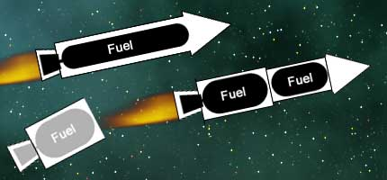
Multistage Rockets
Consist of two or more stages. In multistage rockets, each stage is separated and discarded once its fuel has been consumed.
Purpose: By successively discarding the stage, this reduces the weight of the fuselage and increases the mass ratio of the rocket. This is an effective method of
increasing speed of
the rocket.

Slide 18
How a Rocket Works/Earth to Space Eg SpaceX Falcon 9 and Dragon
http://www.youtube.com/watch?v=L0AMQ6kRNMA

Slide 19
2.2 Surviving There: Technologies for Living in Space

Slide 20
Hazards of Living in Space
People travelling and working in space do not need an Earth-like environment simply for comfort. It is a matter of survival.

Slide 21
Environmental Hazards
Space is a vacuum, with no air or water – they need to be brought, recycled or created.
Cosmic rays are very harmful
Meteoroids could hit
Temperatures can range from unimaginably cold in a shadow to extremely hot in full sunlight.
Atmospheric gases that keep us alive on earth don’t exist in space.
Atmospheric pressure doesn’t exist in space, and that pressure helps regulate our heartbeat.

Slide 22
Psychological Challenges to Confined Living
Long trips in a confined living space may lead to psychological problems. Imagine spending every minute of every day with one person for two years. Now imagine spending that two years in an enclosure not much bigger than this classroom. Stepping outside is strictly prohibited.

Slide 23
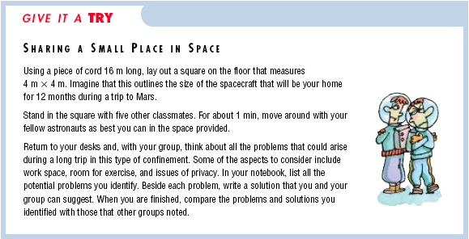

Slide 24
The Body and Microgravity
The Human Body must adapt physically to living in space.
A problem is living in microgravity.
Microgravity: the condition in which the gravitational forces that act on mass are greatly reduced.
Ex. You would only weigh 1/3 of what you weigh on Earth.

Slide 25
NASA in ISS: Angry Birds in Space - What Is Microgravity? (8 March 2012)
http://www.youtube.com/watch?v=wWLbB2eQq_k

Slide 26
The Space Suit
Each custom designed for the astronaut.
Once the astronaut leaves the aircraft, everything they need to survive must be brought with them: air, water, a heating system, a cooling system – even a portable toilet.
See next page for a picture

Slide 27
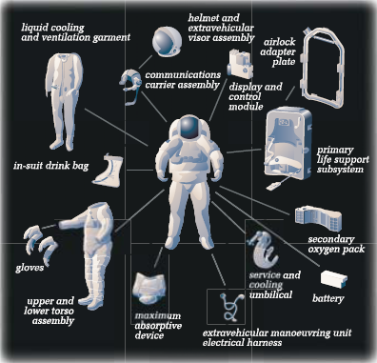

Slide 28
Spacesuit segment from Inside Space on SciFi Channel
http://www.youtube.com/watch?v=9OCg1TNy6Bg
7 min

Slide 29
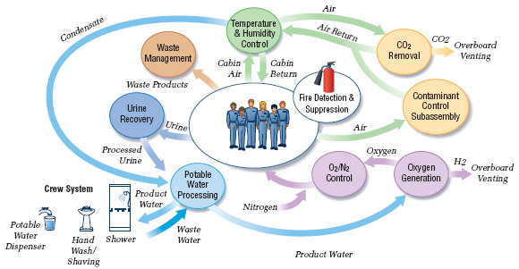
A Home in Space
Very careful planning must go into energy, the life-support systems, and all other equipment that goes into space.

Slide 30
Meeting Needs in Space
Medicine to control motion sickness
Fire-resistant suits
Compact breathing systems
Microelectronics
Wireless communication technology
http://www.youtube.com/watch?v=FdQA-pE2luQ
Waking up, working, and going to sleep in Zero G
17 min

Slide 31
2.3 Using Space Technology to Meet Human Needs on Earth

Slide 32
Using Space Technology to Meet Human Needs on Earth
Although we may not realize it, our daily lives are full of products and systems that were first developed for exploring space. From instant powdered juice drinks and top-of-the-line sports equipment, to satellites that allow us to talk to friends who live far away, we rely on “space age” technology in many ways.

Slide 33
Satellites
Definition: a small body that orbits a larger one.
Satellites play a major role in our lives, performing a variety of functions from space.
Natural: a moon orbiting a planet
Artificial: Spacecraft put into orbit around Earth by humans for research or communication purposes.

Slide 34
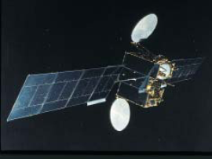
Communication Satellites
Use digital systems that result in clear transmissions and allow for a great number of users at one time.
In the past: wires had to be in place, even in the sea by submarines.
Launched in 1972, Telesat Canada’s
Anik 1 provided Canada with
communication across the continent.
Canada was the first country in the
world to use satellites to transmit
television broadcasts.

Slide 35
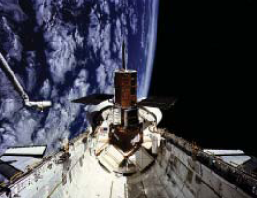
Satellites for Observation and Research
Monitor and forecast weather
Weather satellites stay in one spot above Earth and moves at the same rate as Earth spins – called geosynchronous orbit
Non geosynchronous satellites have been used for follow ships, monitor
soil quality, track forest fires,
report on environmental change,
and search for natural resources.

Slide 36
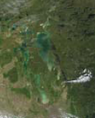
Remote Sensing
Definition: A process in which imaging devices in a satellite make observations of Earth’s surface and send this information back to Earth.
Remote sensing can provide
information on the condition of
the environment, natural resources
effects of urbanization. This info is
used for planning.
Low Earth Orbits are used – they
orbit the Earth faster than the Earth
rotates.

Slide 37
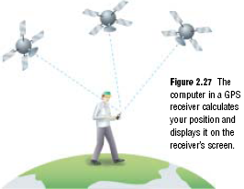
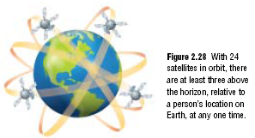
Personal Tracking Devices
GPS (Global Positioning System)
There are 24 GPS satellites in orbit, so you are guaranteed to be in reach of at least 3 at any time.
Radio signals from the satellites are picked up by the receiver. They are then translated by the receiver to show the user his or her position.

Slide 38
Discovery Education – Satellite Technology
(25 min)

Slide 39
GPS Simulation

Slide 40
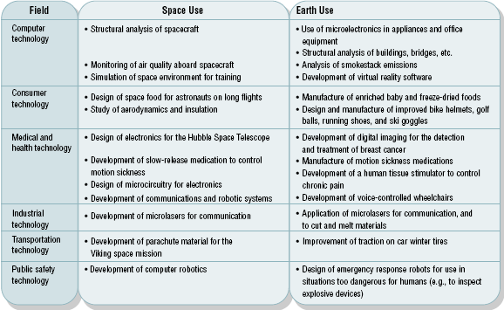
“Space Age” Inspired Systems

Slide 41
PAT Style Questions
Use the following information to answer the next question.
Air, water, and other wastes are recycled aboard the International Space Station. Most of the food that the crewmembers eat is dehydrated. Oxygen is carried in liquid form.
The main reason that the ISS has adopted strategies such as those above is to overcome
The excessive cost of living in space
The lack of storage space aboard a space station
The scarcity of resources on a space station
Issues related to on-board experiments

Slide 42
PAT Style Questions
Use the following information to answer the next question.
Although artificial satellites and piloted spacecraft were achievements of late 20th century, the technology and principles of space travel were discussed much earlier.
The power of rockets to lift objects into space is described by a scientific law first developed by
Keplar
Newton
Pascal
Rutherford

Slide 43
PAT Style Questions
Use the following information to answer the next question.
The most powerful rocket is the Energia multistage rocket, which was used by the Soviet Space Shuttle. In multistage rockets, each stage is separated and discarded once its fuel has been consumed.
The successive discarding of stages is done in order to
Reduce the weight of the fuselage and increase the mass ratio of the rocket
Reduce the cost of launching
Minimize the efforts of the scientists
Decrease the speed of the rocket

Slide 44
PAT Style Questions
Space shuttles are used for deploying satellites into orbit, carrying out scientific experiments, and repairing orbiting satellites. Which of the following functions is also a function of a space shuttle?
Taking photographs in space
Returning previously deployed satellites to Earth
Forecasting weather conditions
Observing celestial bodies

Slide 45
PAT Style Questions
Ion drives are engines that use xenon gas instead of chemical fuels. Solar sails use the
Energy of the wind to propel spacecraft
Electromagnetic energy of the sun to power the spacecraft
Heat energy of the sun to push the spacecraft
Recycled energy of conventional hydrocarbon fuels to propel the spacecraft

Slide 46
PAT Style Questions
The “payload” of a spacecraft refers to the
Materials carried aboard
Rocket fuel
Oxidizer
Combustion chamber

Slide 47
PAT Style Questions
Use the following information to answer the next question.
As a result of zero gravity, crewmembers aboard spacecraft experience weightlessness.
Weightlessness causes physical complications that may include all of the following except
Blocked sinuses
anemia
Extra weight gain
Loss of bone tissue

Slide 48
PAT Style Questions
A Russian cosmonaut, Valeri Polyakov, completed a 438-day tour of duty aboard the Mir Space Station in 1995.
Which of the following aspects of living in space is the least hazardous for humans?
Lower food consumption
Psychological issues
Microgravity
The presence of environmental dangers

Slide 49
PAT Style Questions
In order for an object to be launched into space, the object has to
Withstand the range of temperatures in space
Overcome the force of Earth’s gravity
Withstand the presence of other celestial bodies
Overcome problems due to pollution

Slide 50
PAT Style Questions
Russia became the first country to launch an artificial satellite in 1957. This satelite was called
Luna
Alouette
Soyuz
Sputnik

Slide 51
Review
List the three main types of spacecraft currently being used.
In a rocket, what does a payload refer to?
What limits how long an astronaut can stay out in space in his or her space suit?
Explain why a space suite must have both a heating unit and a cooling unit.
Why is it necessary to recycle almost all of the water used on a spacecraft such as the International Space Station?
Why do you require at least three satellites to determine your position?
What is remote sensing?
What does GPS stand for?

Slide 52
Unit 2 Quiz

